Slide 1
Carib Brewery Grenada Limited
SCTCM Report
September 2026

Slide 2


GRENADA Safety Pyramid
CBG, SAFETY REPORT, august 2026
Fatalities
0
0
LTIs
0
0
Accidents
RWC MTC FA VA FLT PD
RWC MTC FA VA PD
2
0
3
0
0
0
0
0
0
0
0
UC-UB Reports / % of YTD Budget
Reports YTD
% of YTD Budget
Reports YTD
% of YTD Budget
6533
172%
0
0
UC-UB Closure Rate YTD
76%
0
Employees
Contractors

Slide 3
HSE KPI’S – UC-UB REPORTS
CBG, SAFETY Report august ‘26
CBG UC-UB Reporting 2026 Actual vs Budget & 2025

Slide 4
HSE KPI’S – ACCIDENTS
CBG, SAFETY REPORT, Aug 2026

Slide 5
KPI’S – AUDITS
CBG, SAFETY REPORT, Aug. ’26
CBG Audits 2026 Actual vs Budget

Slide 6
Production- CAPEX Status SEPTEMBER 2026
Name | Description | Status | Timeline
New Boiler | Refurbish Boiler #2 | P.O submitted for required parts, pending ETA from supplier. | 30-Dec
New Silo | Install 70-Ton Silos and Malt handling | Quote received from Kunzel and Tonsen, Review of technical comparison commenced and CAPEX to be completed in November 2026. | 31-Mar 2027
High Gravity Brewing | Install relevant equipment to introduce high gravity brewing at CBG | Carbo blender: Received proposals from Alfalaval, SPI, and Krones. Technical assessment commenced, Capex to be submitted October 2026. Aldox DAW module: Received proposal from Sulca. Discount negotiations commenced and Capex request to be submitted. | 30-Apr 2027
Plastic Pallet Upgrades | Replace wooden pallets in production and sales with Plastic pallets. | Capex to be submitted for qty. 1920 @ US$75 each (ex factory) from ORBIS | 30-Dec

Slide 7
Production 2026- YTD KPI’s

Slide 8
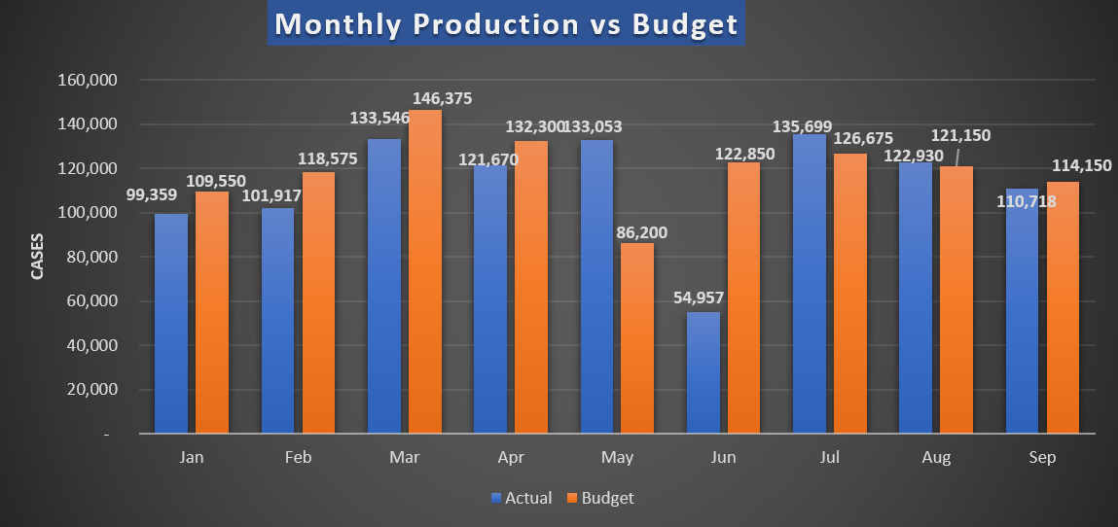
Production- Packaging Line
September actual: 3,432 cases under budget.

Slide 9
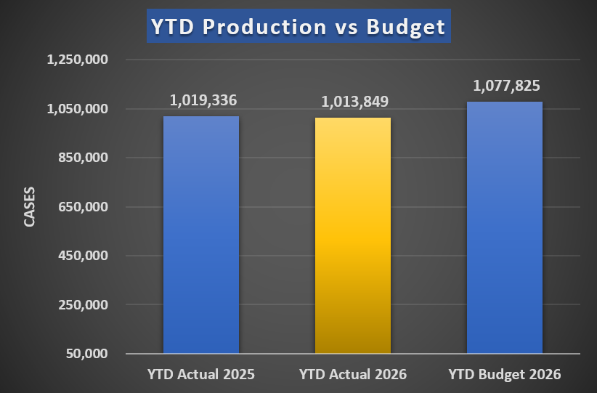
Production- Packaging Line
YTD actual –63,976 cases under budget
YTD 2026 – 5,487 cases under 2025 Actual cases

Slide 10
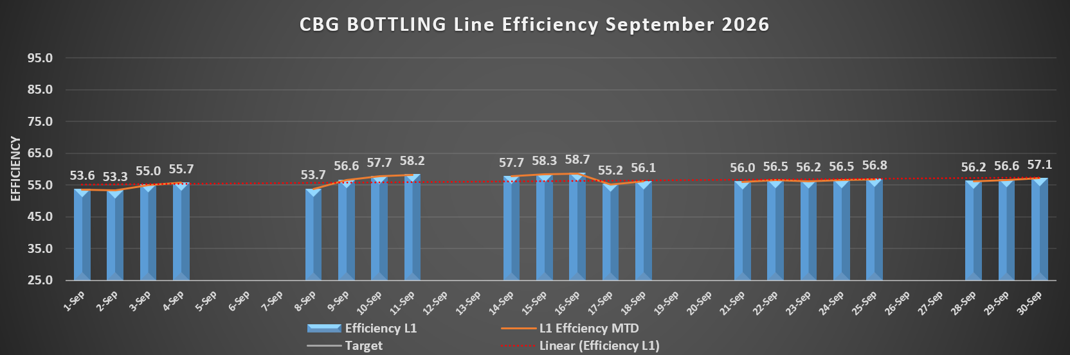
Production- Packaging Line

Slide 11
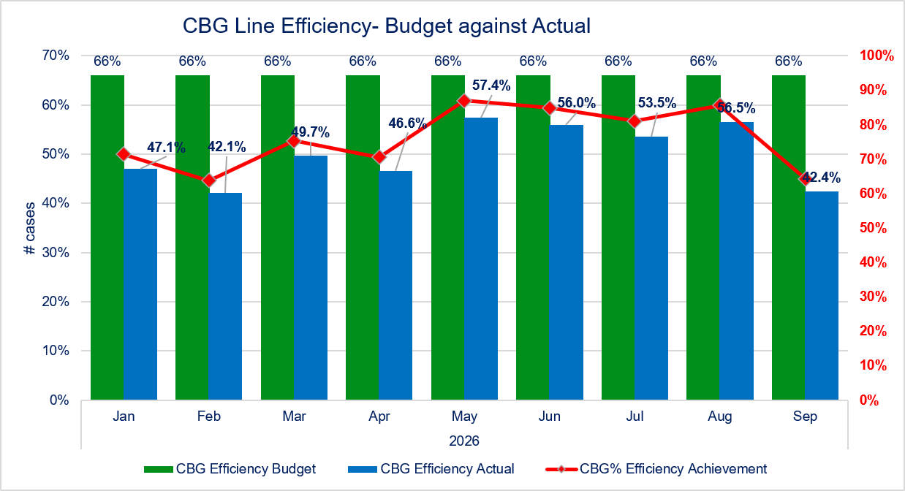
Production- Packaging Line
Line efficiency –42.4%
13.6% below target for September.
CBG Efficiency Budget
CBG Efficiency Actual
CBG% Efficiency Achievement

Slide 12
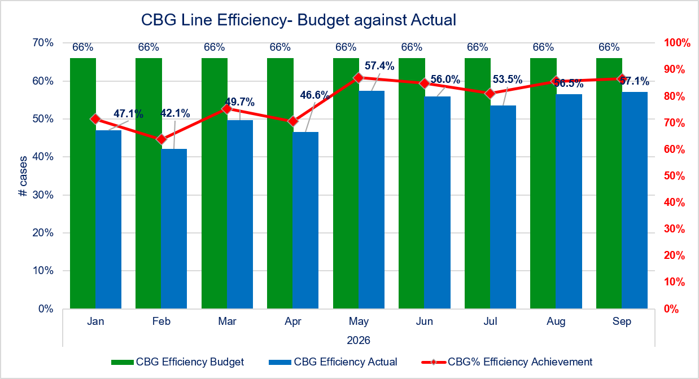
Production- Packaging Line
Line Utilization –57.1%
8.9% under target for September.

Slide 13
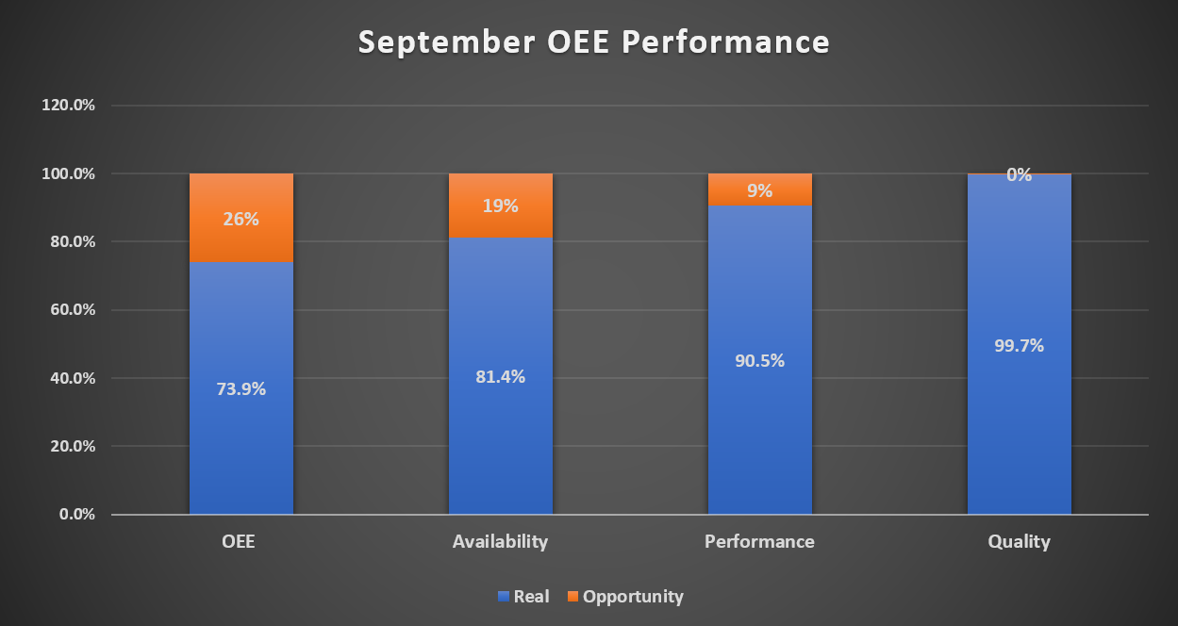
Production- Packaging Line –OEE
September OEE Actual- 73.9% (1.9% above target)

Slide 14
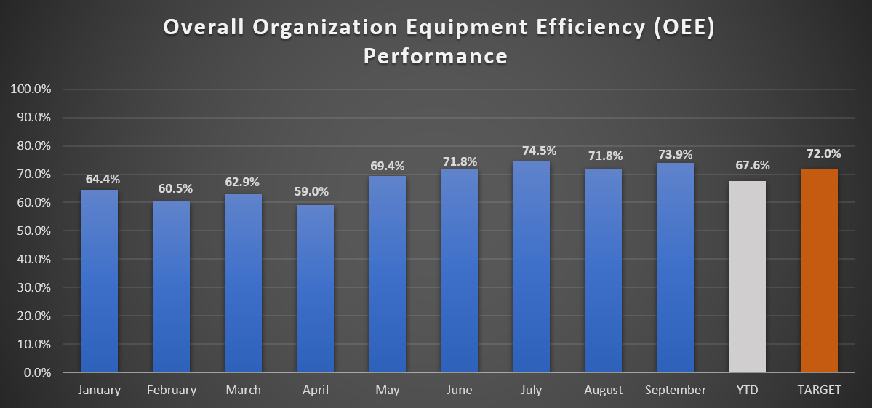
Production- Packaging Line –OEE
August OEE YTD – 67.6% (4.4% under target)

Slide 15
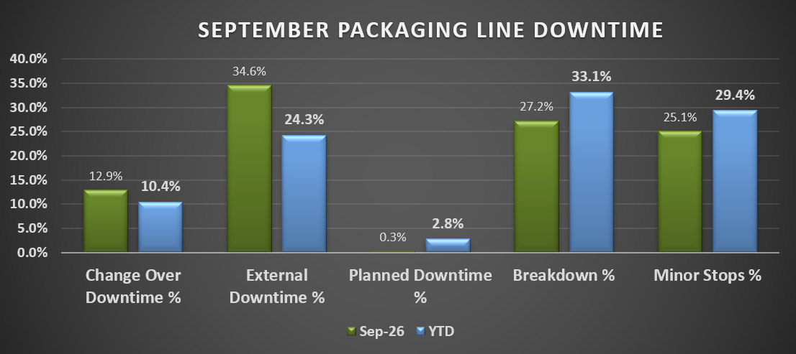
PRODUCTION- PACKAGING LINE
Minor stops: (32.5hrs)
  High EBI rejection
  Uncaser head hitting crates
  Fallen bottles in EBI Star wheel and OSW
  Fallen bottles on Conveyor lines (shuffler, filler infeed, pasteurizer discharge)
  Fallen/broken bottles jamming in Washer infeed and discharge flaps
  High rejection due to labels
  Label adjustments (flagging, missing & start up adjustments)
  Crowner stuck in chute/hopper
  Crowner self flushing
Breakdowns: (35.3hrs)
  Repairs to valve #34 on filler
  Crown stop sensor issues- not allowing crowns into chute
  Videojet not printing properly
  Packer sensor malfunction
  Stop to drop pasteurizer tank level and refill
  Test bottle failure
  Low temperature on Washer
  Cartoon erector destroying boxes
  Cartoon erector sealing issues
  Cartoon erector malfunction
  Dry run
  Magazine adjustments
  Low temperature on pasteurizer
External: (44.8hrs)
  Lunch break due to lack of manpower (8.8hrs)
  Cider product blending (12.6hrs)
  Washer loading (3.4hrs)
  Awaiting product analysis (3.3hr)
  Boiler lock out (1.5hrs)
  High rejection due to rewashed (1.5hrs)
      19 Change over: (16.7hrs)

Slide 16
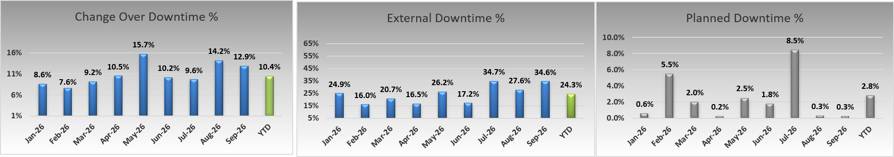
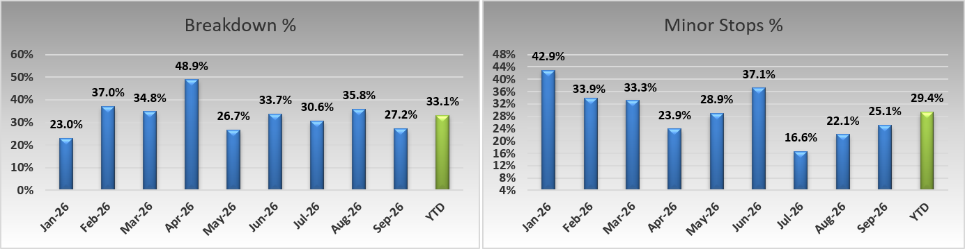
Production- Packaging Line
Organizational Losses
Technical Losses

Slide 17
PRODUCTION- PACKAGING LINE
Pareto Line 1 Timestealers

Slide 18
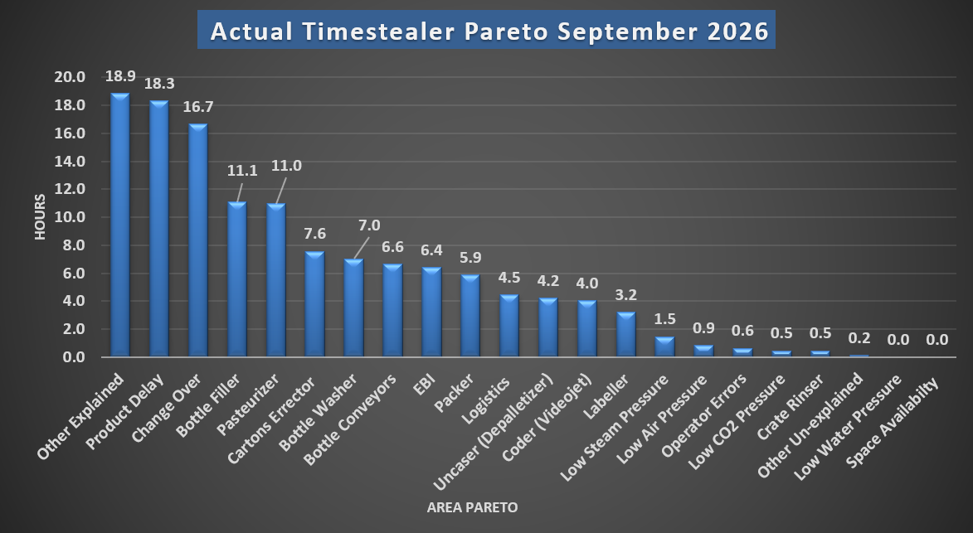
September 2026 Timestealers
Top 4 Time Stealers
Other Explained: Lunch break due to lack of manpower (8.8hrs), washer loading (3.4hrs), boiler lock out (1.5hrs), high rejection due to rewashed (1.5hrs).
Product Delay: Cider product blending (12.6hrs), awaiting product analysis (3.3hr).
Change Over: product change overs.
Bottle Filler: Repairs to valve #34 (3.2hrs), crown stop sensor issues- not allowing crowns into chute (2.6hrs), crowns sticking inside chute/ hopper (1.9hrs).

Slide 19
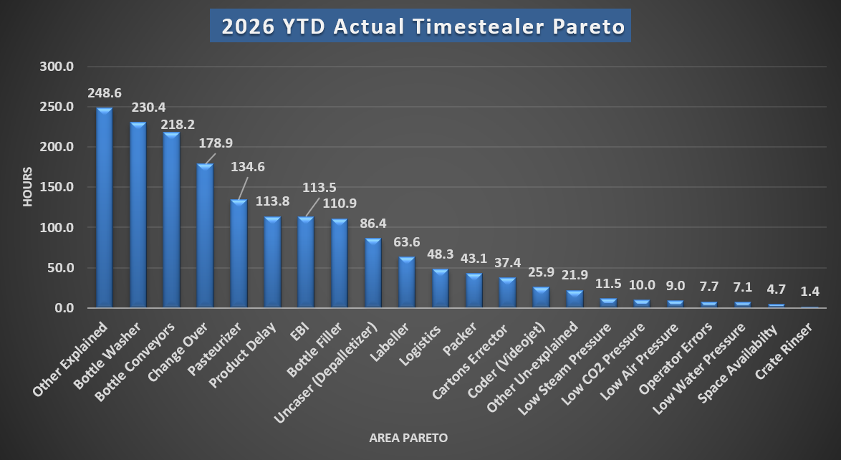
Top 4 Timestealers and Actions to Address
Top 4 Equipment Time Stealers:​
Other Explained: Low water supply on plant due to NAWASA issue, Starmalt relabeling, lunch break due to insufficient manpower, product preparation, washer loading, townhall meeting, absenteeism of Filler operator, staff punctuality and boiler lock out.
Bottle Washer: Significant downtime was experienced on the bottle washer in Feb and March. During the shutdown in June for pasteurizer installation, San Martin also did works on the bottle washer. There has been a marked improvement in the adequacy of the wash as well as notable decrease in downtime caused by the washer. Monitoring will be ongoing.
Bottle Conveyors: Issues were predominantly at the infeed and discharge conveyors from the EBI with various communication faults experienced. This was most significant in January, with noted improvement after issues were addressed by OEM. Other issues at labeler infeed were rectified after replacement of a damaged sprocket. A full review of conveyors will be done in Q3 to determine any other areas that require action. There were a lot of instances of fallen bottled inside shuffler.
Change Over: Product change overs.

Slide 20
Production- Packaging Line
Two (2) biggest downtimes (Details & resolution) – SEPTEMBER 2026
Filler downtime analysis (11.1hrs) | Response
Repairs to valve #34 (3.2hrs) Crown stop sensor issues- not allowing crowns into chute (2.6hrs) Crowns sticking inside chute/ hopper (1.9hrs)
Pasteurizer downtime analysis (11hrs) | Response
Waiting on dry run (9.3hrs) Low temperature (2.5hrs) Stop to drop tank level and refill (2.5hrs)

Slide 21
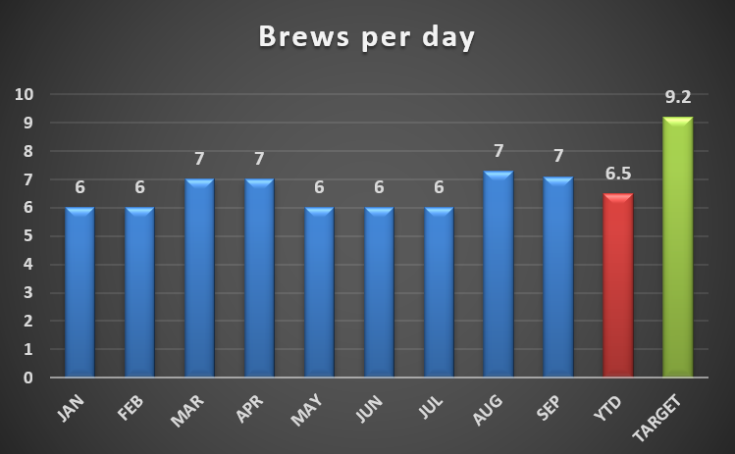
Production – Brewing Performance 2026
Average brews per day for September was 7.1.
YTD brews per day is 6.5.

Slide 22
Brewing Issues- Forward Approach
 | Area of Focus | Plan
1 | Malfunctioning valves at wort kettle | Requisition under review and awaiting final approval.
2 | Steam and air supply interruptions | Brewing was affected by an air compressor failure and periods of low steam pressure. Shift men responded to the interruptions and restored normal operating conditions.
3 | Mash tun slide valve | Servicing was completed, with improved performance observed in September.
4 | Faulty on wort external boiler emptying valve | Valve repaired to restore proper operation.

Slide 23
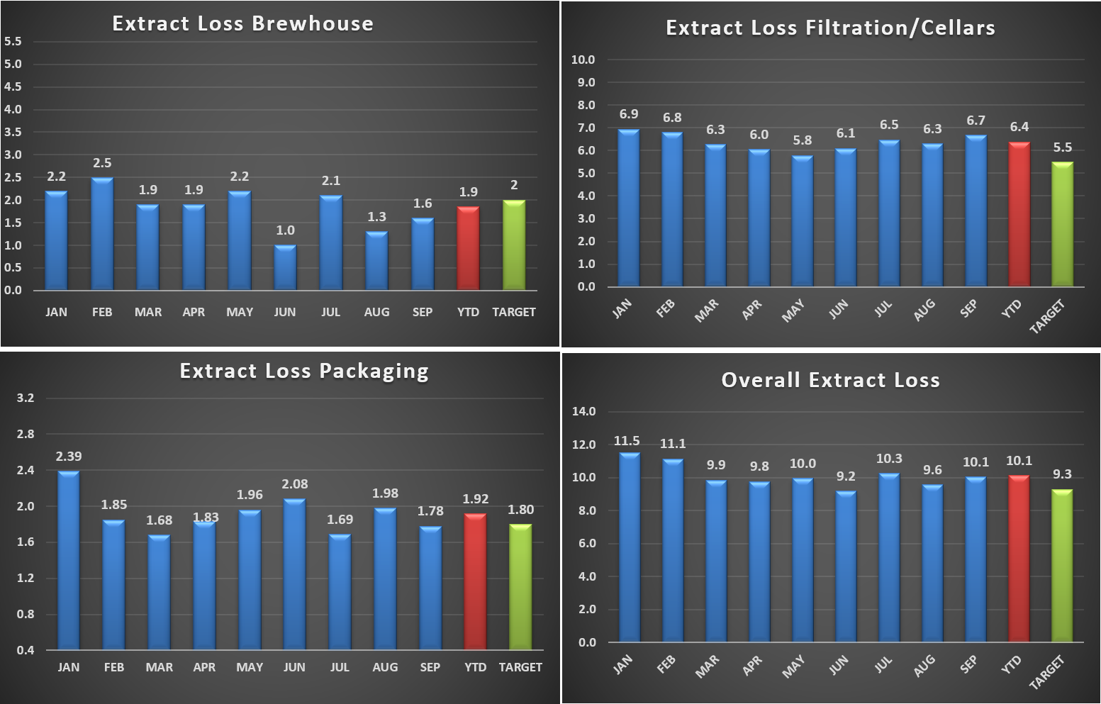
Production – Brewing Performance- Extract Losses
Brewhouse Extract loss – MTD- 98.4% ( within target)
Filtration/Cellars Extract Loss - MTD- 6.7% (1.2% above target)
Packaging loss – MTD- 1.8% (on target)
Overall Extract loss – MTD- 10.1% (0.8% above target)

Slide 24
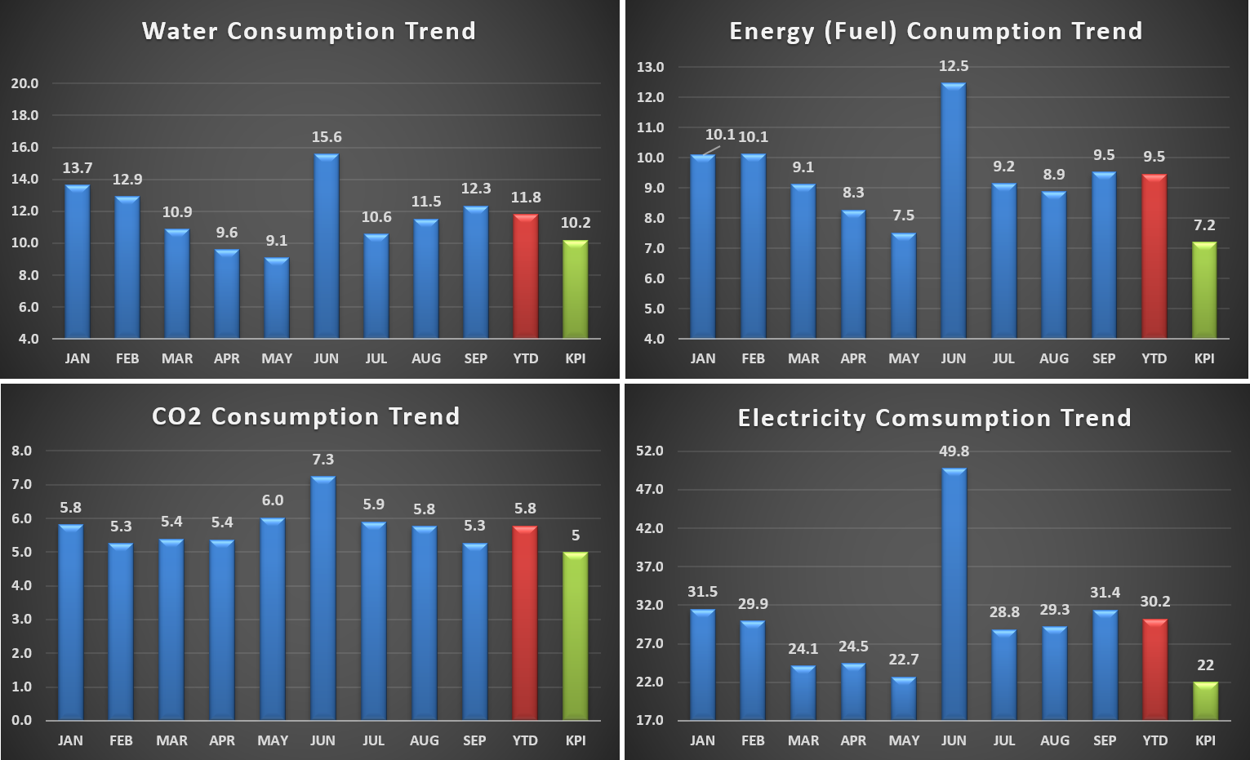
Supply chain – utilities monthly breakdown
Water – MTD- 12.3% (2.1 above target)
Fuel – MTD- 9.5% (2.3 above target)
CO2 Consumption - MTD- 5.3% (0.3 above target)
Electricity – MTD- 31.4% (9.4 above target)

Slide 25
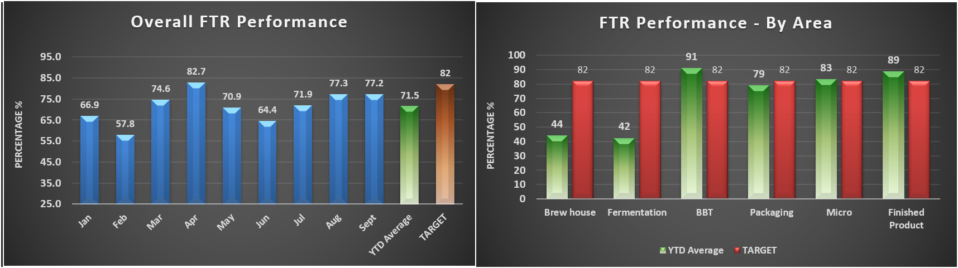
QUALITY- FTR
SEPTEMBER FTR was 77.2% versus an 82% target. YTD 2026: 71.5%.​
​
Key factors: ​
Brewing 45% (Brewing Time 47%, Cast Gravity 92%,Aeration Level 100%)​
Fermentation –48% (Fermentation Speed 100%, FVSV Fill duration 71%, Yeast Dosage 100%, Yeast Storage 67%, Pitch Yeast 100%)​
Micro –85% (Micro Pack-Micro Tunnel 100%, Micro Beer-Micro Ferment 85%)​
Finish Product –98% (Colour 98%, PG 100%, ISO-H 100%, TIPO 100%)​
Packaging –89% (PU 91%, Fill Volume 100%, Packaging Index 89%)​
BBT- 99% (Colour 100%, PG 99%, CO2 100%, DO 100%, Haze 100%)

Slide 26
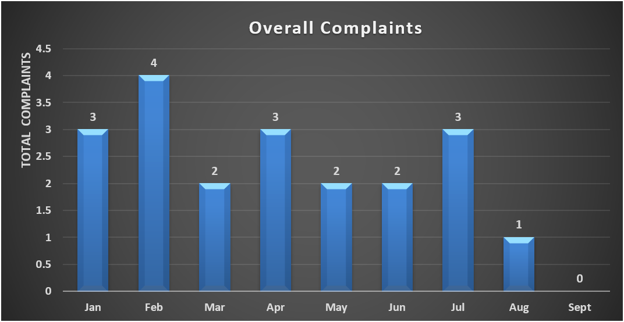
QUALITY – LOCAL CONSUMER COMPLAINTS
Complaints
0 customer complaint received for September 2026.

Slide 27
QUALITY – LOCAL COMPLAINTS

Slide 28
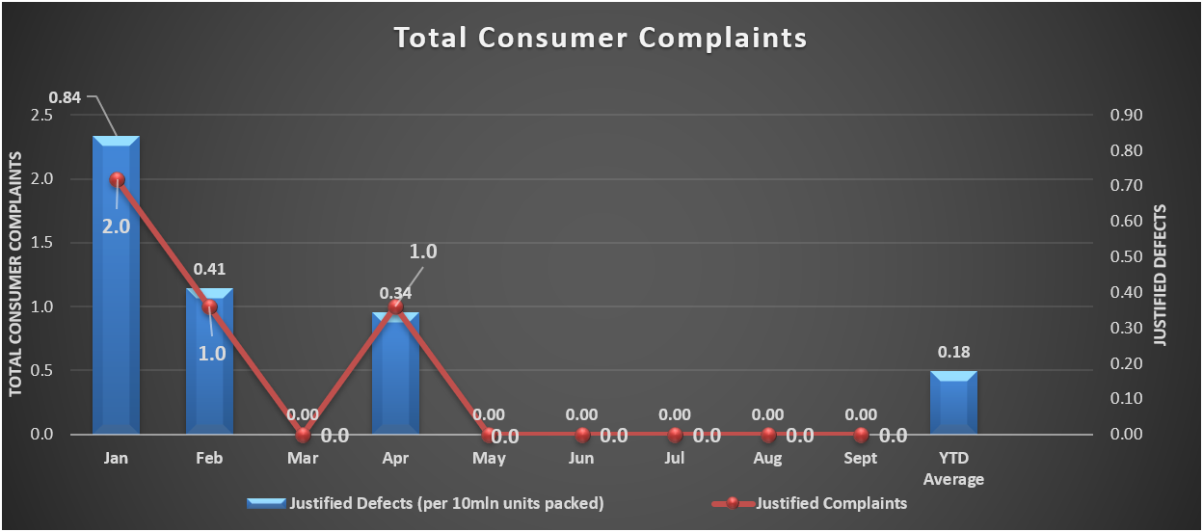
QUALITY – LOCAL CONSUMER COMPLAINTS

Slide 29
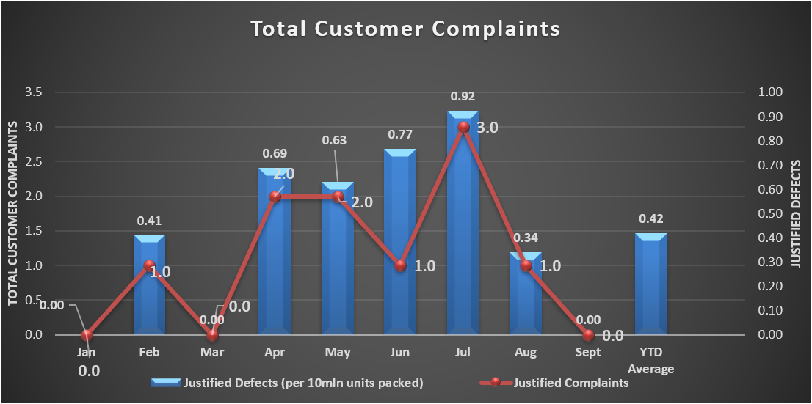
QUALITY – LOCAL CUSTOMER COMPLAINTS
There were 0 customer complaint received for September 2026.

Slide 30


